Slide 1
Federal Way Link Extension
Motion No. M2019-64
Task Order with City of Kent
6/13/2019

Slide 2
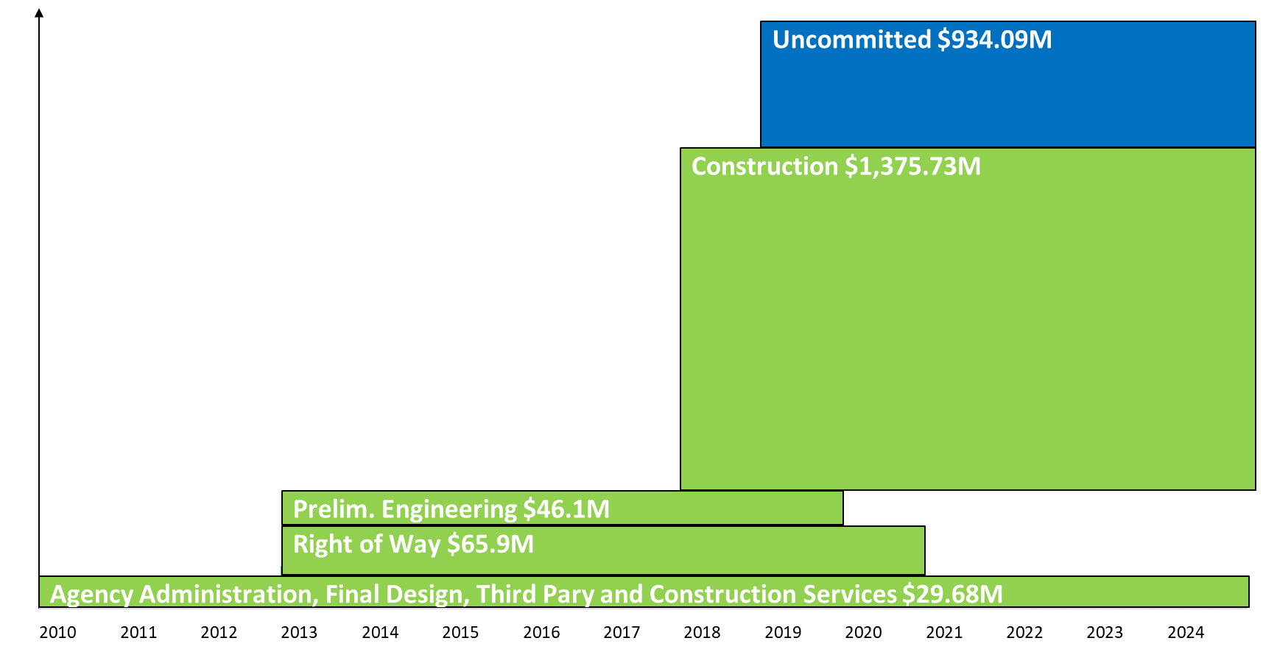
Illustrative - Not to Scale
FEDERAL WAY LINK EXTENSION: Baseline Budget $2,451.5M
ALLOCATION $ COMMITMENTS
$2,451.5M
Design Build
Proj. Dev.
Approved
Today’s Action
Future Action
Notes:
The next two slides provide a graphical representation of the project’s current status with respect to its baseline budget and contractual commitments as well as today’s action.
This first slide illustrates the status of the Federal Way Link Extension project. The project has a baseline budget of $2.451B represented by the vertical bar on the left-hand side of the slide. The entire bar is highlighted in green indicating that the Board has approved budget for the entire project. The project was baselined in Aug 2018.
On the right-hand side, each box represents contract commitments by phase. Of the $2.451B baseline budget, there is $934.09M yet to be committed.

Slide 3
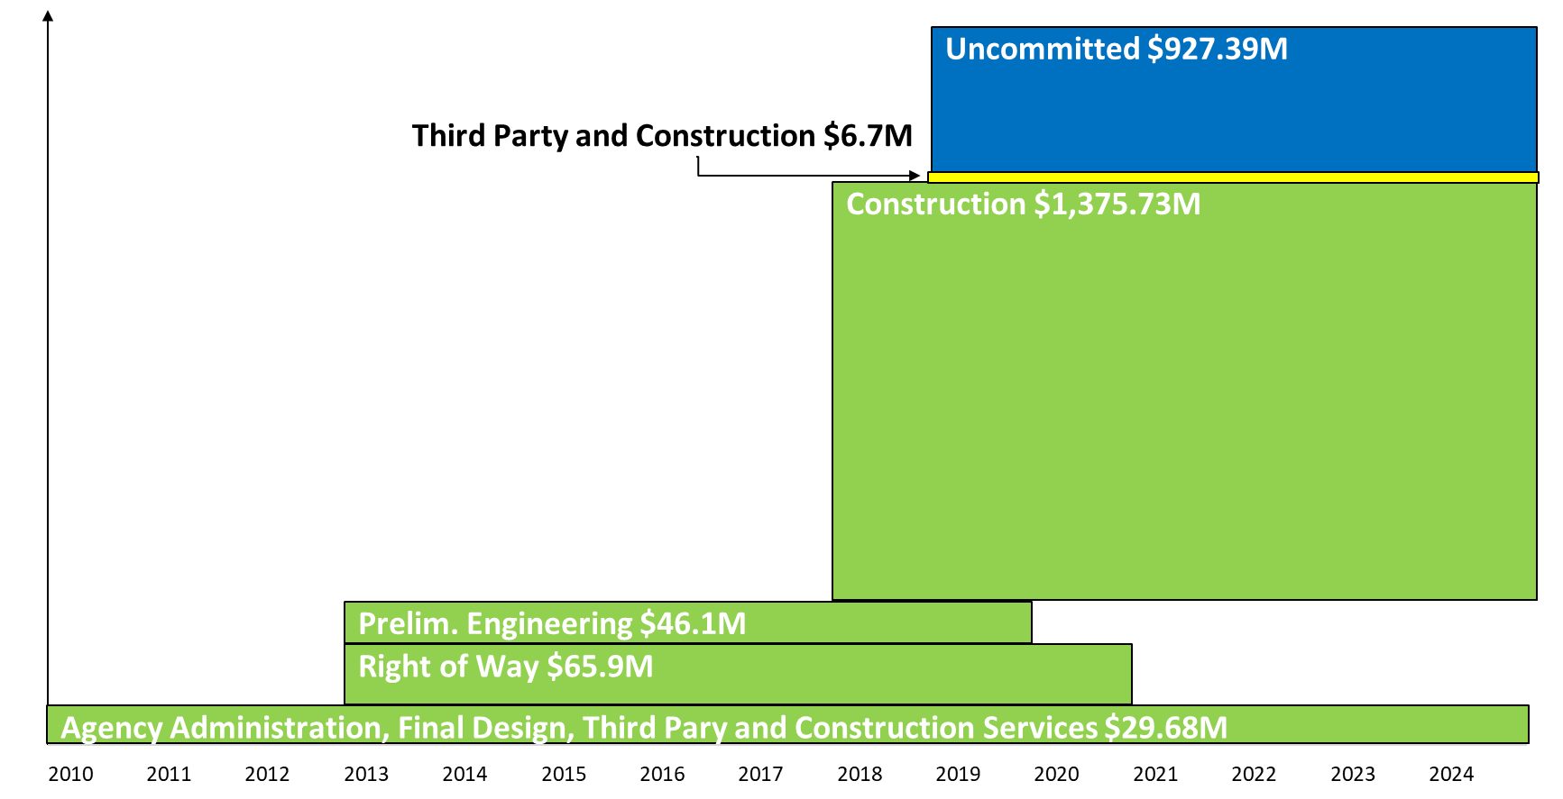
Illustrative - Not to Scale
FEDERAL WAY LINK EXTENSION: Board Approves Agreement $6.7M
ALLOCATION $ COMMITMENTS
$2,451.5M
Design Build
Proj. Dev.
Approved
Today’s Action
Future Action
Notes:
This slide illustrates today’s action. The yellow box highlights an increase to the third party and construction phase commitments for an agreement with City of Kent for $6.7M – reducing the uncommitted budget to $927.39B.

Slide 4
Thank you.

